Slide 1

Track My Subscriptions
Submitted To: Submitted By:
Mr.Anik Sen Mohammad Arafat Ali
Assistant Professor Id -1603110201187
Department of Computer Science Suchitra Das
& Engineering Id -1603110201209
Premier University, Chittagong. Abdul Karim
Id -1603110201188

Slide 2
Introduction
“Track My Subscription” is a subscription tracking tool offering notifications, reminders, and payment type management
Users can manage their own subscriptions
Providing facilities to change ownership of subscriptions

Slide 3
Goal
Developing a web-based application by which users manage multiple subscriptions in one platform

Slide 4
Related Work
Truebill [1]
Help users stop paying for things no longer required
Trim [2]
It is a financial management tool that enables users to view recurring charges and manage subscriptions
Appsumo [3]
A simple platform for keeping track all of the subscriptions in one spot

Slide 5
Motivation
Currently there is no single platform for managing subscriptions along with ownership change
Our platform allows user changing ownership of subscriptions

Slide 6
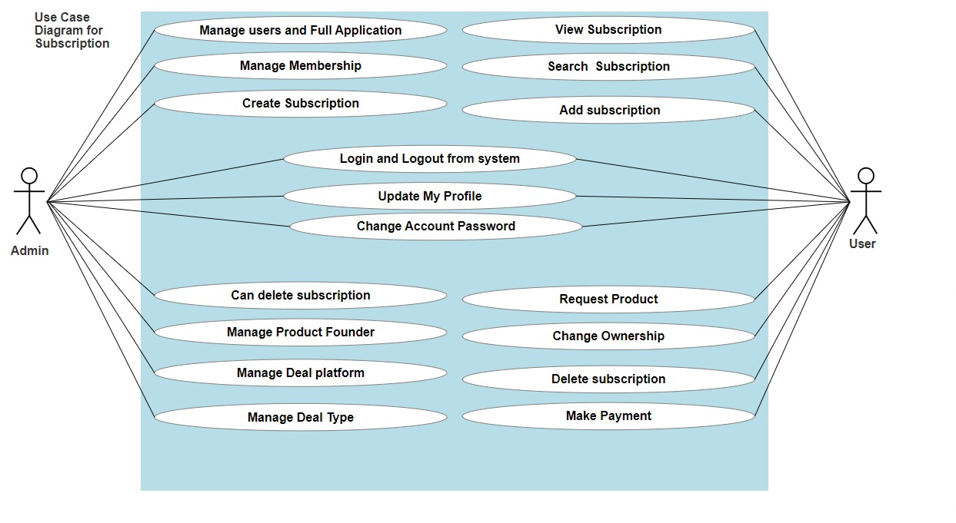
Use Case Diagram of the system

Slide 7
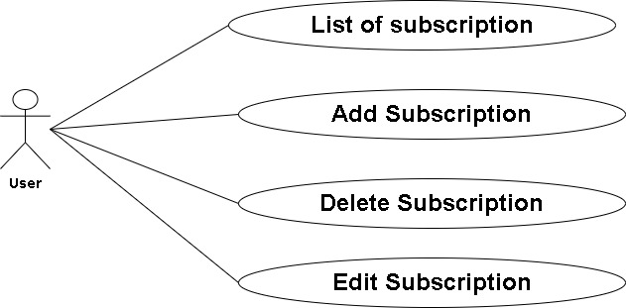
Use Case Diagram (Contd)
Manage Subscriptions

Slide 8
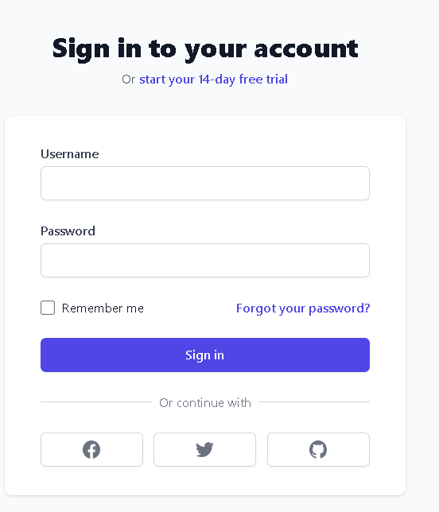
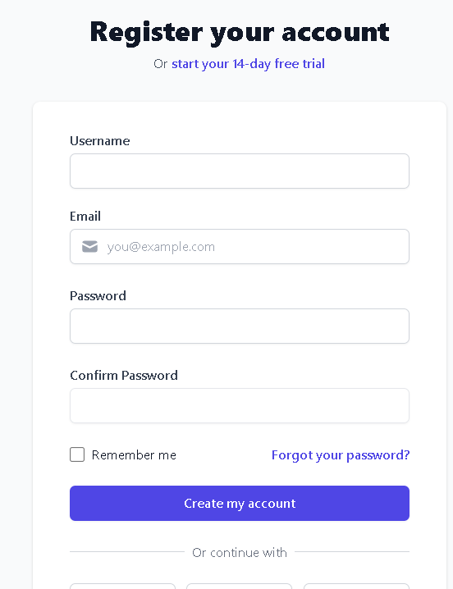
Features of Authentication
Log in
Register

Slide 9
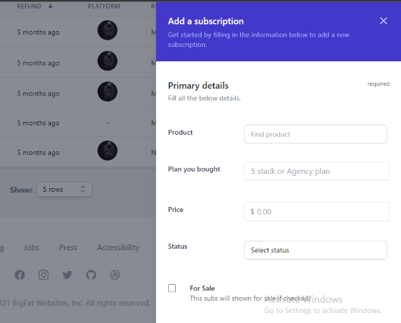
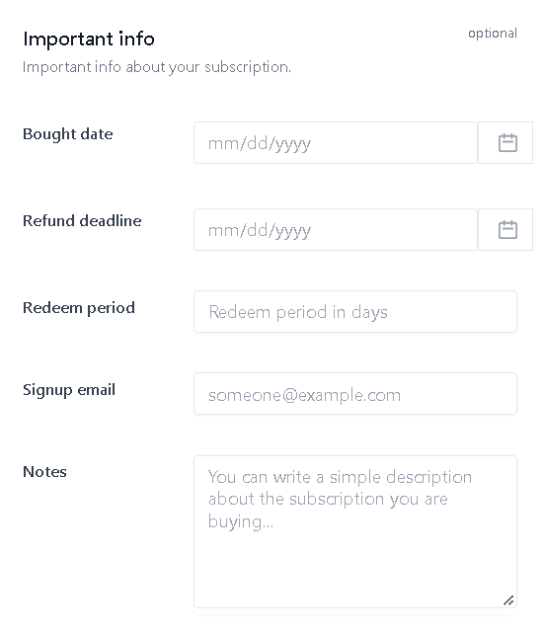
Features of User
Add Subscription

Slide 10
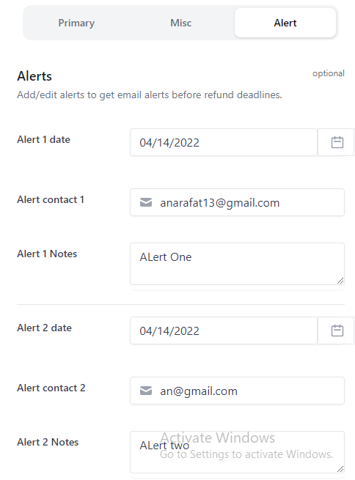
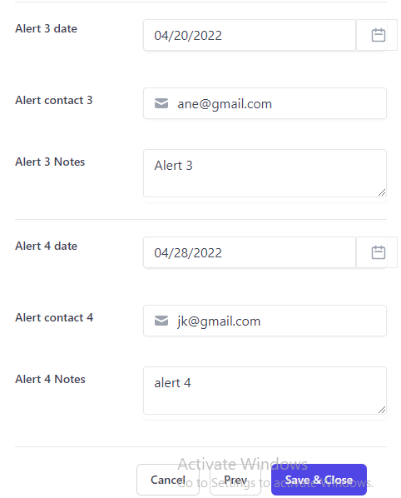
Features of User (Contd)
Alert

Slide 11
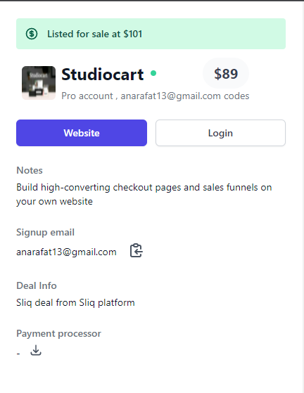
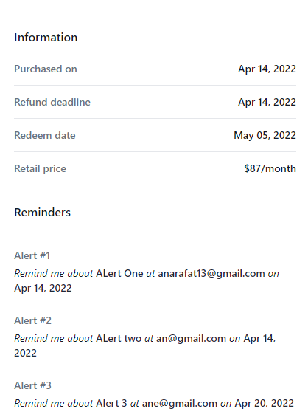
Features of User (Contd)
Subscription details

Slide 12
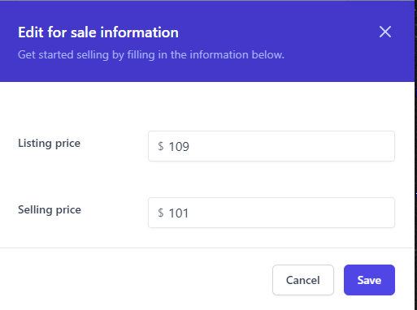
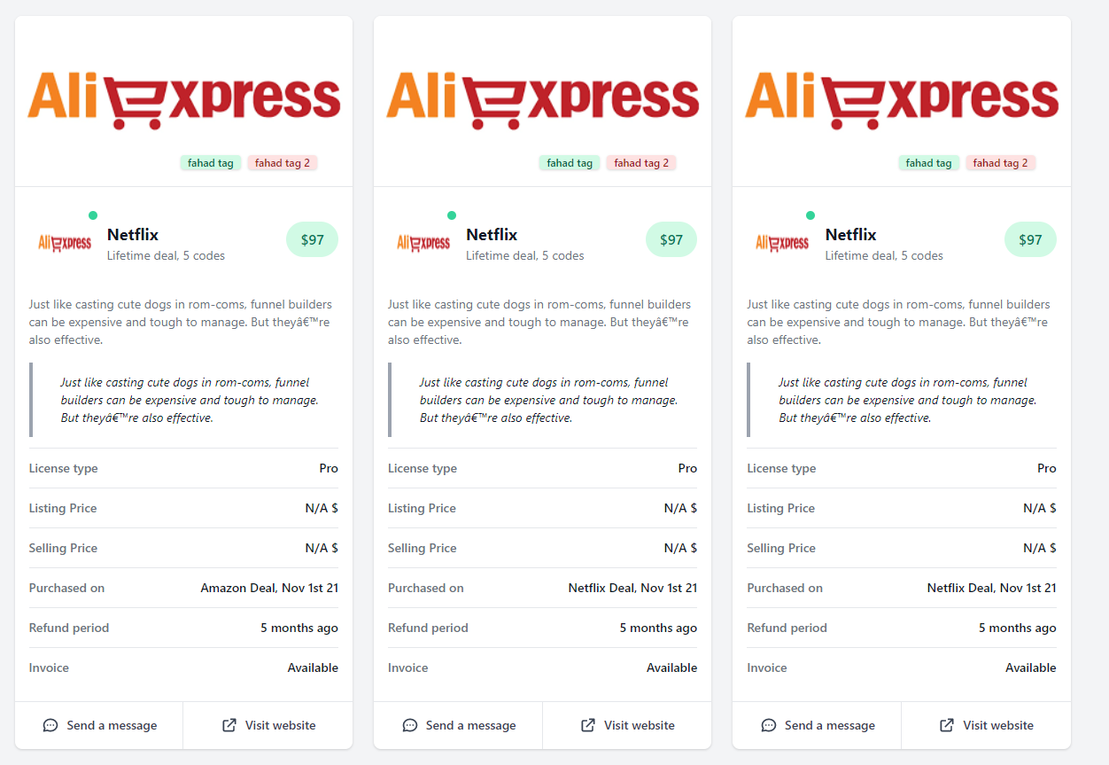
Features of User (Contd)
Recycle Subs info
Recycled Subs list

Slide 13
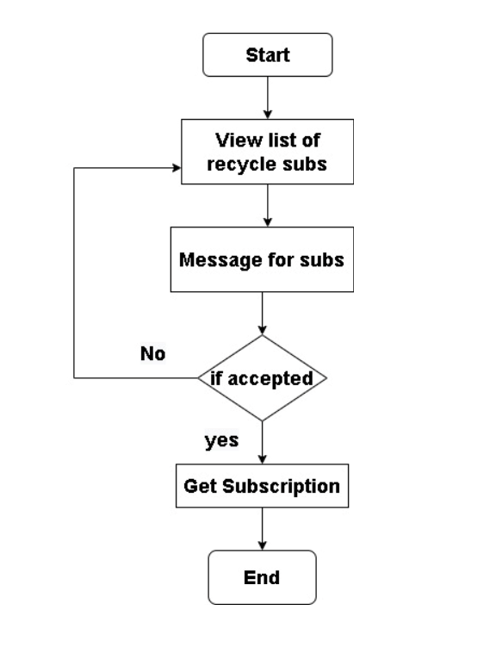
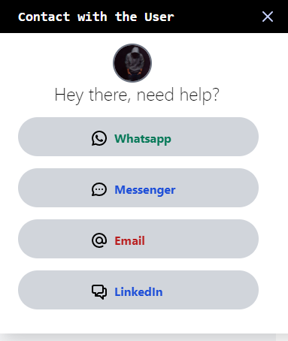
Features of User (Contd)
Change Ownership

Slide 14
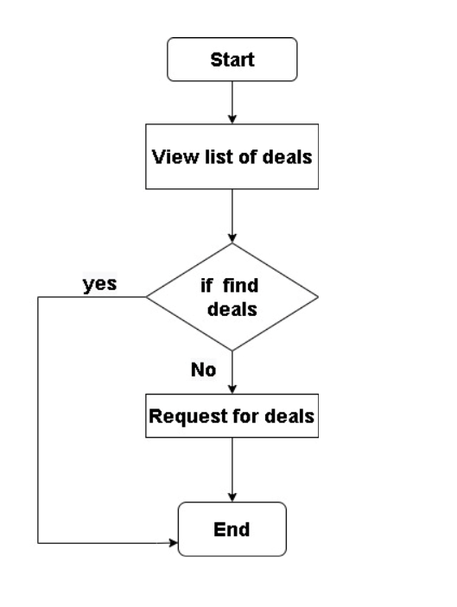
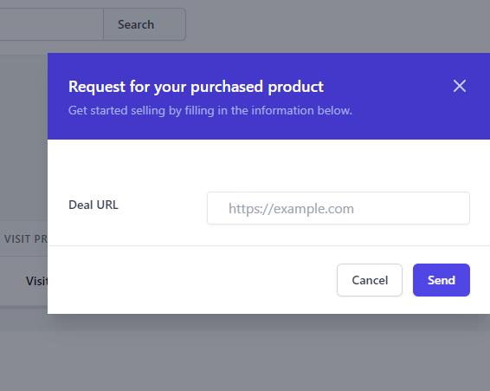
Features of User (Contd)
Request Product

Slide 15
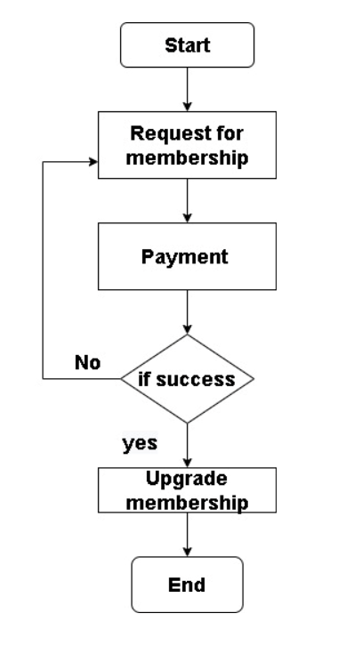
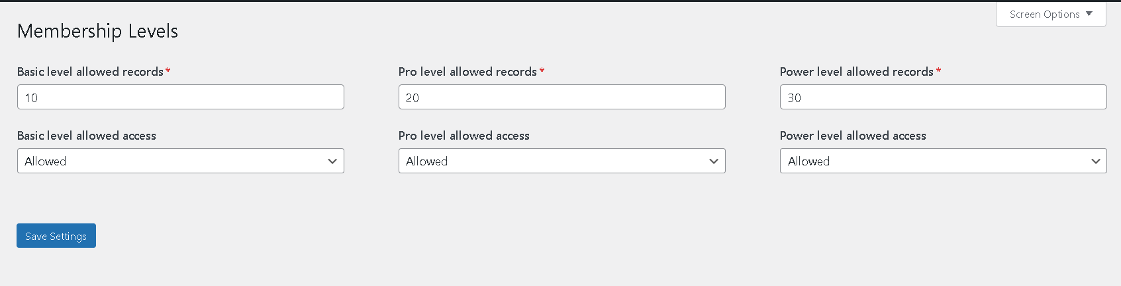
Features of Admin
Manage Membership

Slide 16
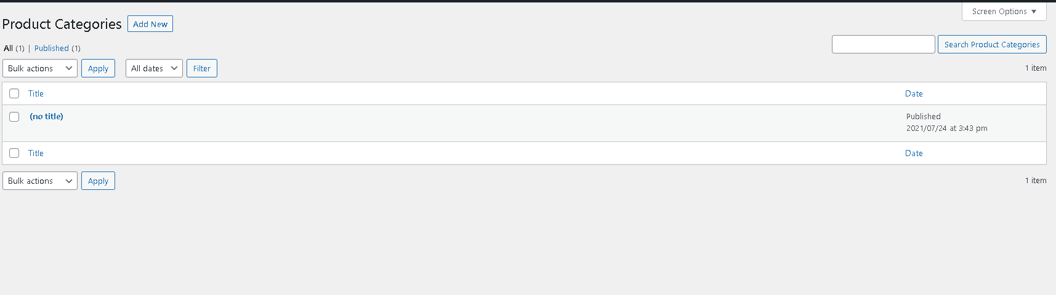
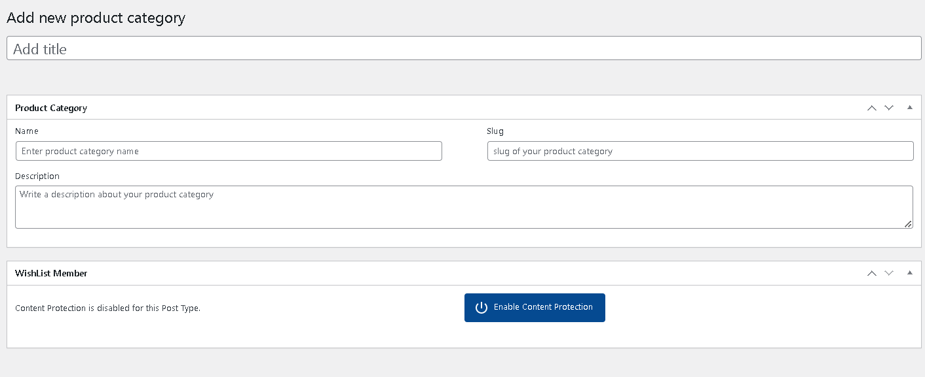
Features of Admin (Contd)
Deal Categories
Add new Deal Category

Slide 17
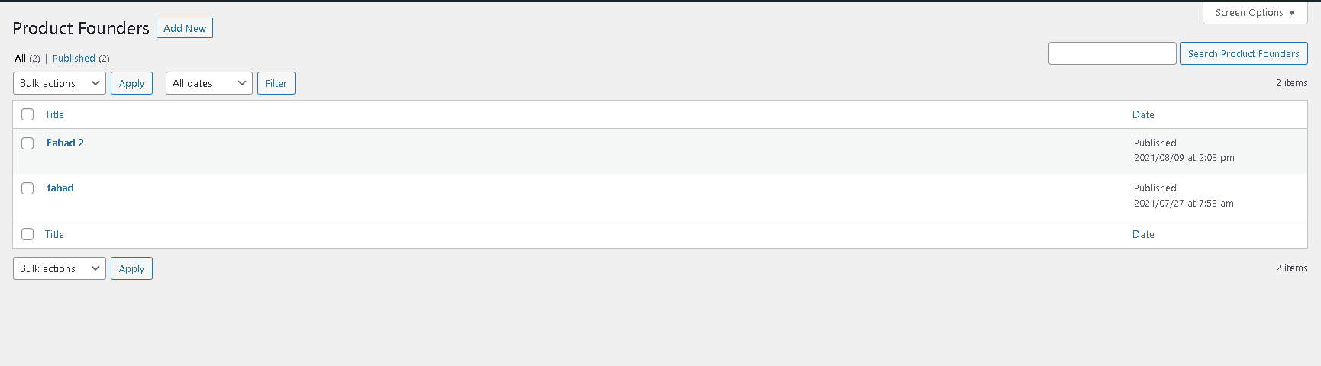
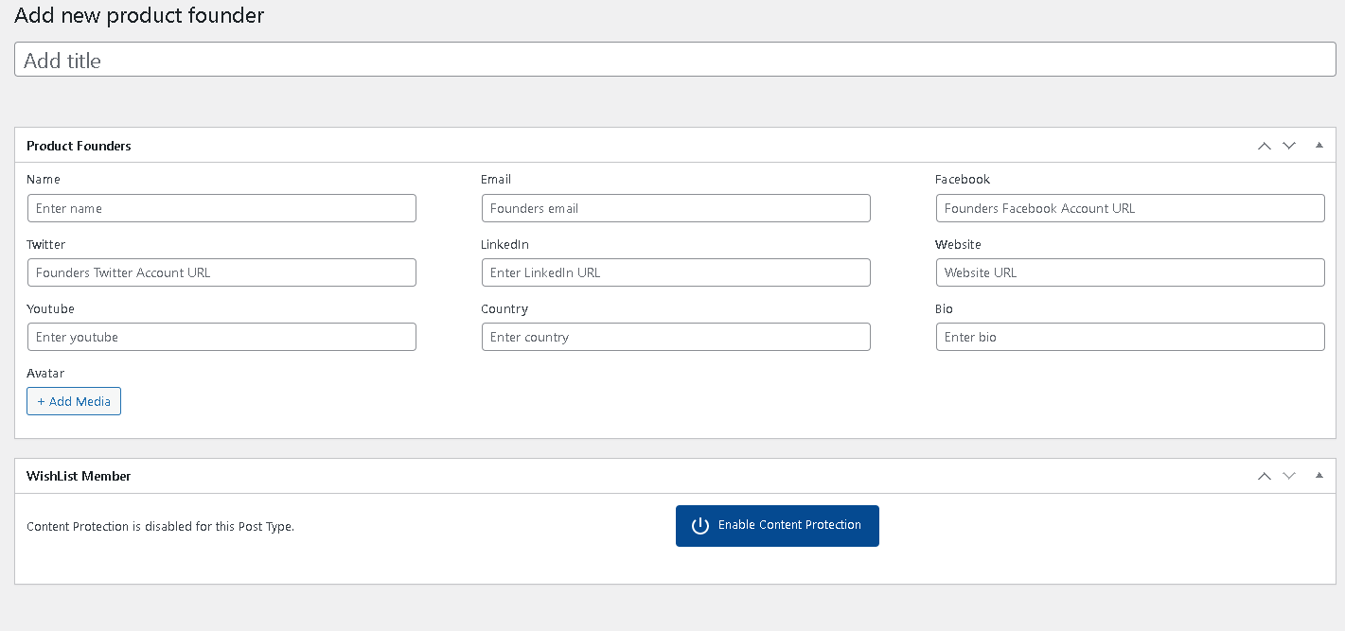
Features of Admin (Contd)
Deal Founders
Add new Deal Founder

Slide 18
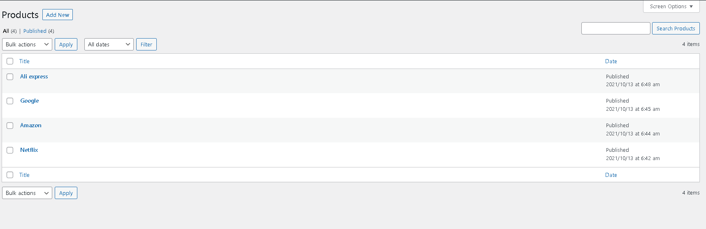
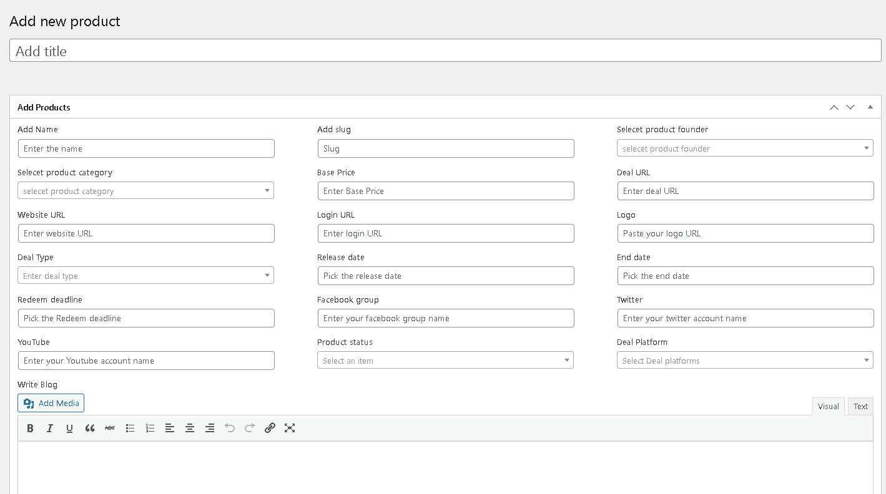
Features of Admin (Contd)
Deals
Add New Deal

Slide 19
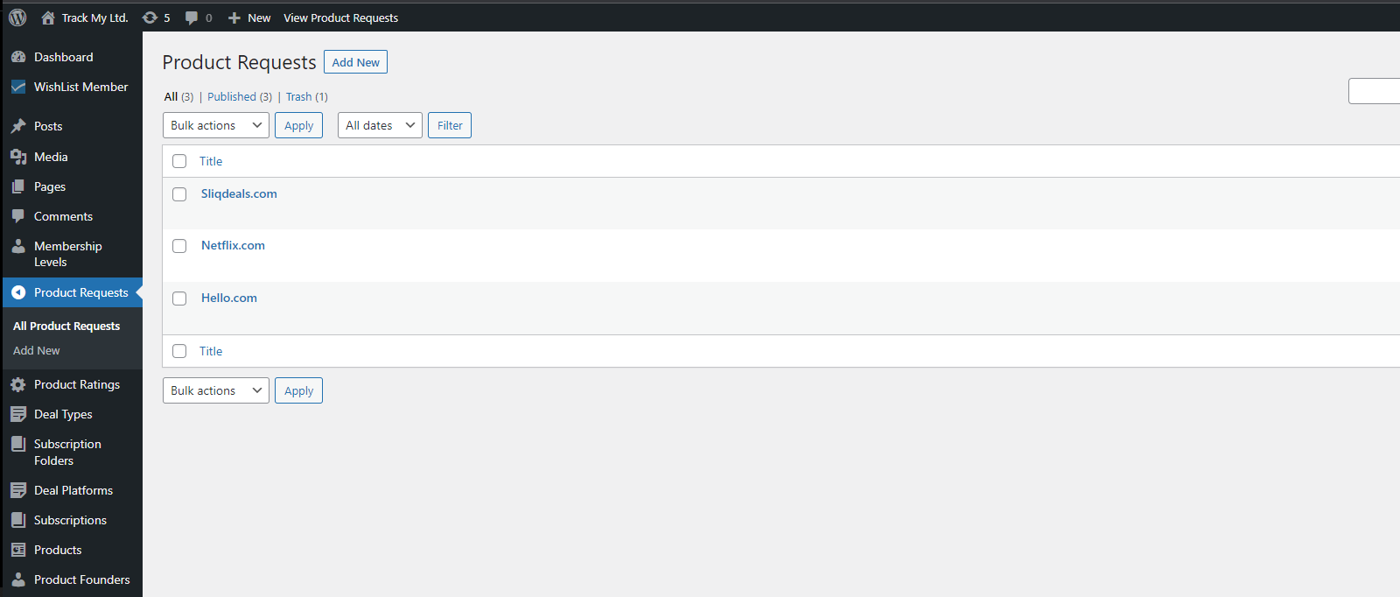
Features of Admin (Contd)
Requested Product

Slide 20
Limitations & Future Works
Currently developed for web platform
Will develop it for mobile apps
Admin cannot monitor the ownership change
Will develop a chat system
Will integrate payment gateway

Slide 21
Technologies
Wordpress
PHP
MySQL
Vue.js
Tailwind

Slide 22
Conclusion
“Track My Subscription” is a subscription monitoring tool featuring notifications, reminders, and payment type control
It delivers automated reminders and warnings to avoid unnecessary subscriptions
It allows users to track spending month-to-month and estimate remaining budget for the current month
And Also changing ownership of purchasing subscriptions
Integrated SPA (vue.js) inside wordpress

Slide 23
References
[1] https://www.truebill.com/feature/manage-subscriptions [Accessed on: 31 March, 2022].
[2] https://money.usnews.com/money/personal-finance/saving-and-budgeting/articles/track-and-manage-subscriptions-with-these-apps [Accessed on: 31 March, 2022].
[3] https://appsumo.com/products/subscription-tracker-and-management-notion/ [Accessed on: 31 March, 2022].
[4] https://www.guru99.com/what-is-php-first-php-program.html [Accessed on: 1 April, 2022].
[5] https://www.techtarget.com/searchcontentmanagement/definition/WordPress [Accessed on: 1 April, 2022].
[6] https://community.codenewbie.org/lanrewaju/100daysofcode-chapter-1-html-and-css-basics-3 709#:~:text=What%20is%20HTML%3F,for%20web%20 pages%20and%20applications. [Accessed on: 1 April, 2022].
[7] https://developer.mozilla.org/en-US/docs/Learn/CSS/First_steps/What_is_CSS [Accessed on: 1 April, 2022].
[8] https://en.wikipedia.org/wiki/JavaScript [Accessed on: 1 April, 2022].
[9] https://v2.vuejs.org/v2/guide/?redirect=true [Accessed on: 1 April, 2022].
[10] https://www.siteground.com/tutorials/php-mysql/mysql/#:~:text=MySQL%20is%20a%20fre ely%20available,ease%20and%20flexibility%20of%20use [Accessed on: 1 April, 2022].
[11] https://www.geeksforgeeks.org/introduction-to-tailwind- css/#:~:text=Tailwind%20CSS%20is%20basically%20a,have%20to%20fight%20to%20override [Accessed on: 1 April, 2022].

Slide 24
References (Contd)
[12] https://www.toppr.com/ask/question/web-server/ [Accessed on: 1 April, 2022].
[13] https://www.wpbeginner.com/glossary/apache [Accessed on: 1 April, 2022].
[14] https://www.webopedia.com/definitions/browser/ [Accessed on: 1 April, 2022].
[15] https://code.visualstudio.com/docs [Accessed on: 1 April, 2022].
[16] https://en.wikipedia.org/wiki/XAMPP [Accessed on: 1 April, 2022].

Slide 25
Thank you

Slide 26
Appendix

Slide 27
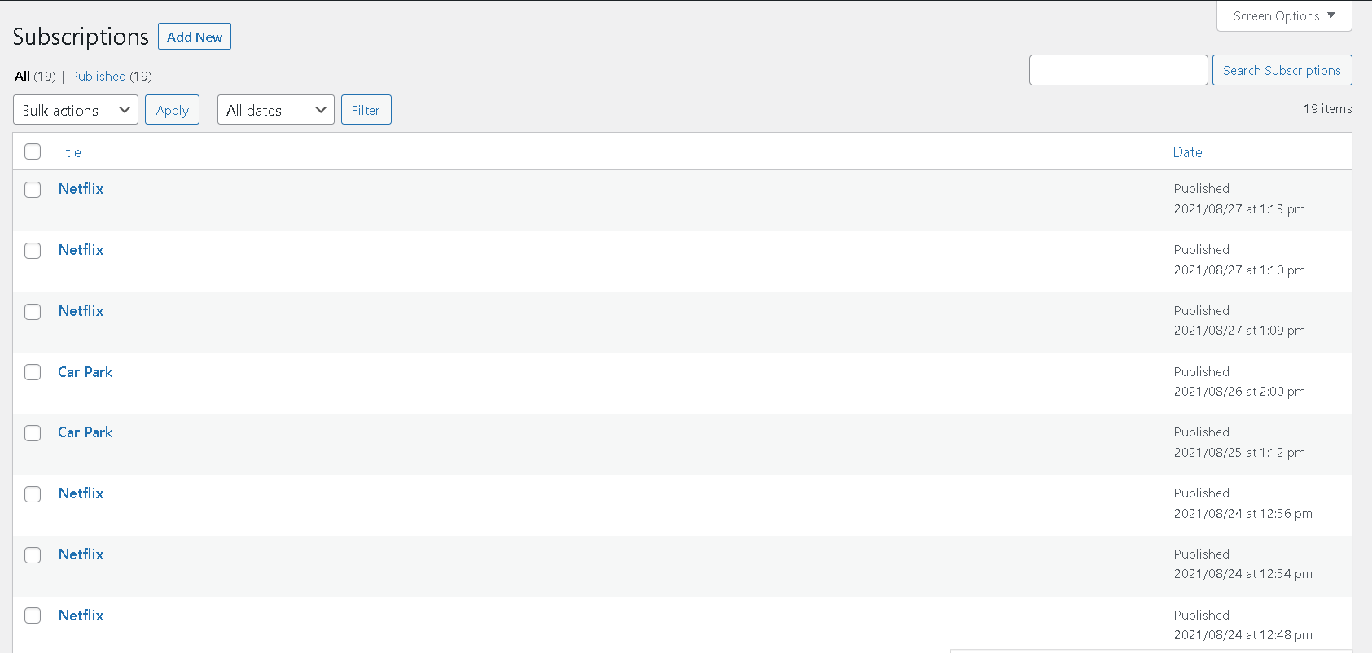
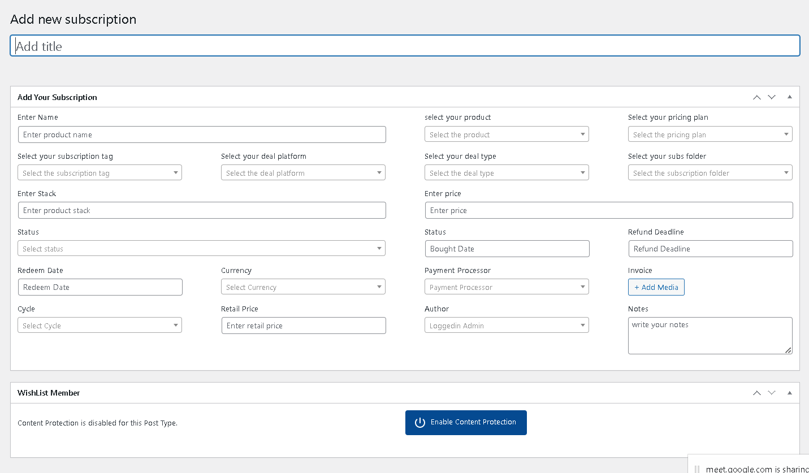
Features of Admin (Contd)
Subscriptions
Add New Subscriptions

Slide 28
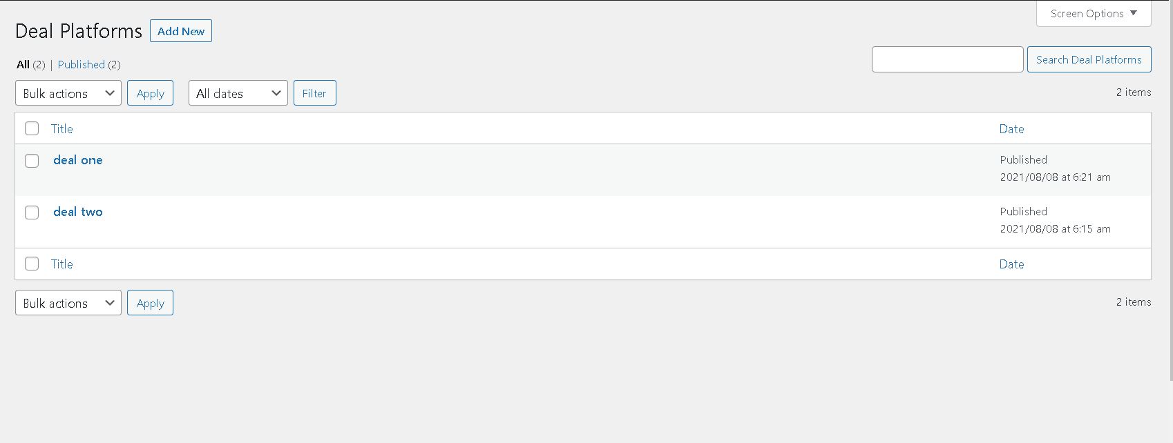
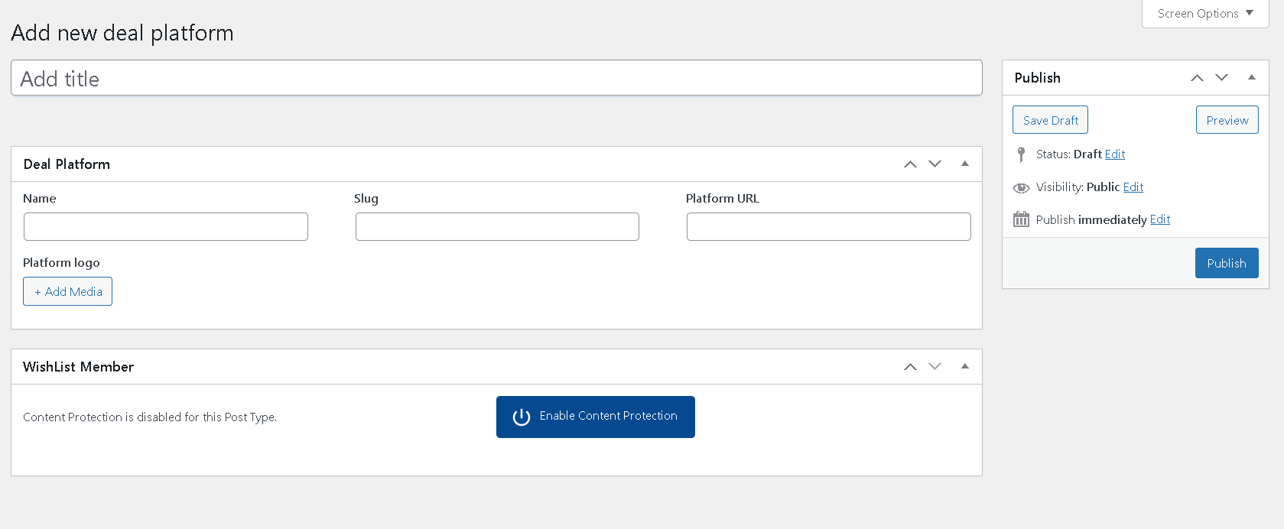
Features of Admin
Deal Platform
Add New Deal Platform

Slide 29
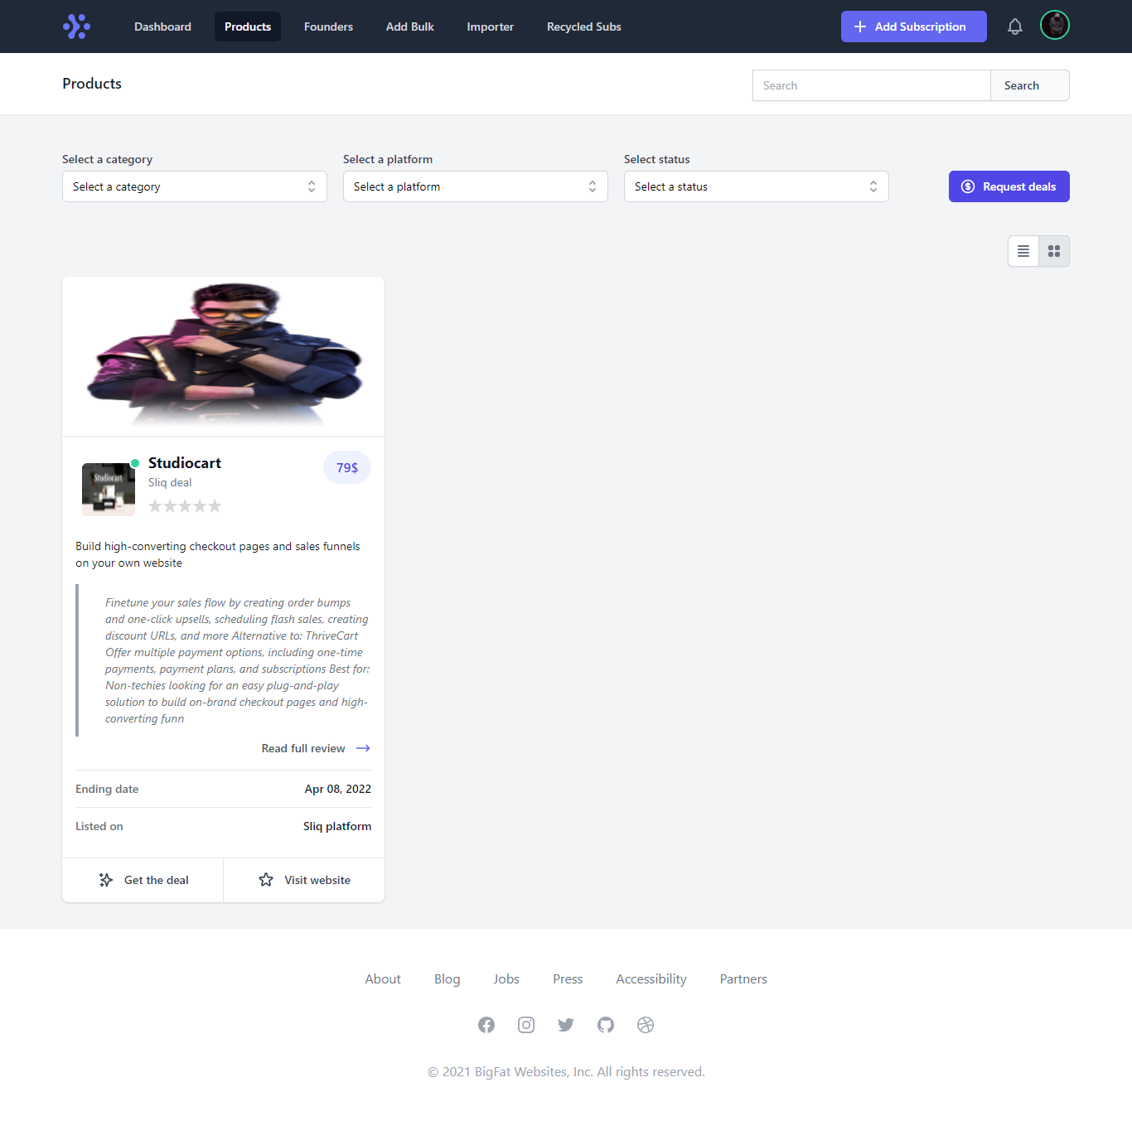
Features of User
Subs for sale info
Products

Slide 30
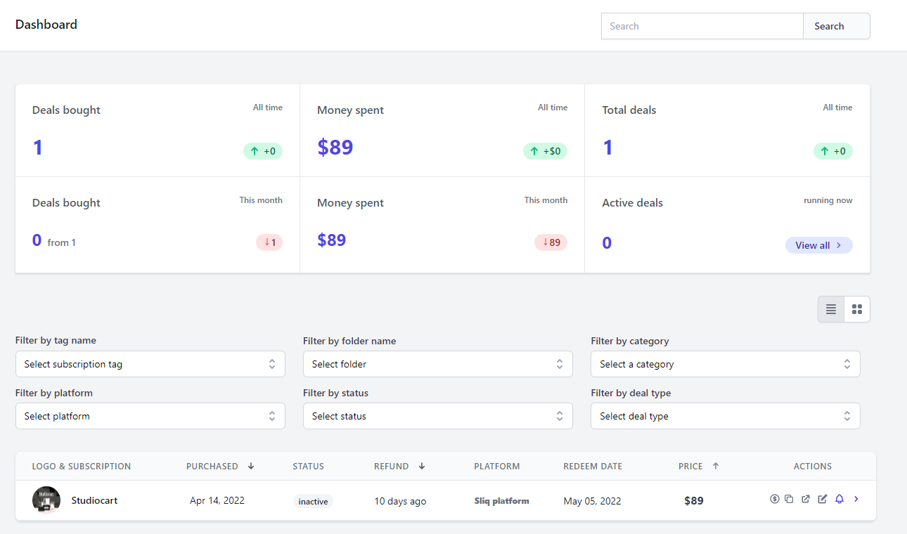
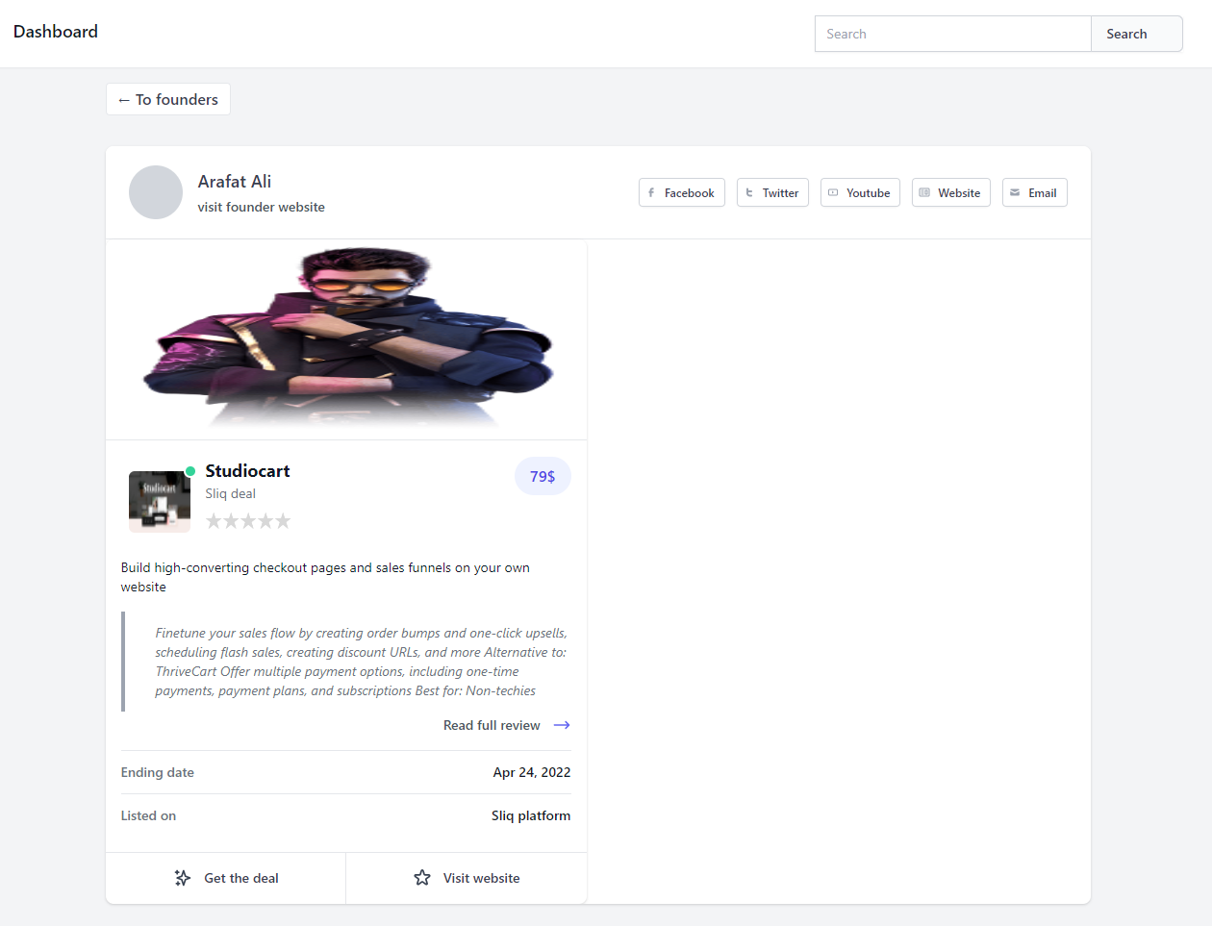

Slide 31
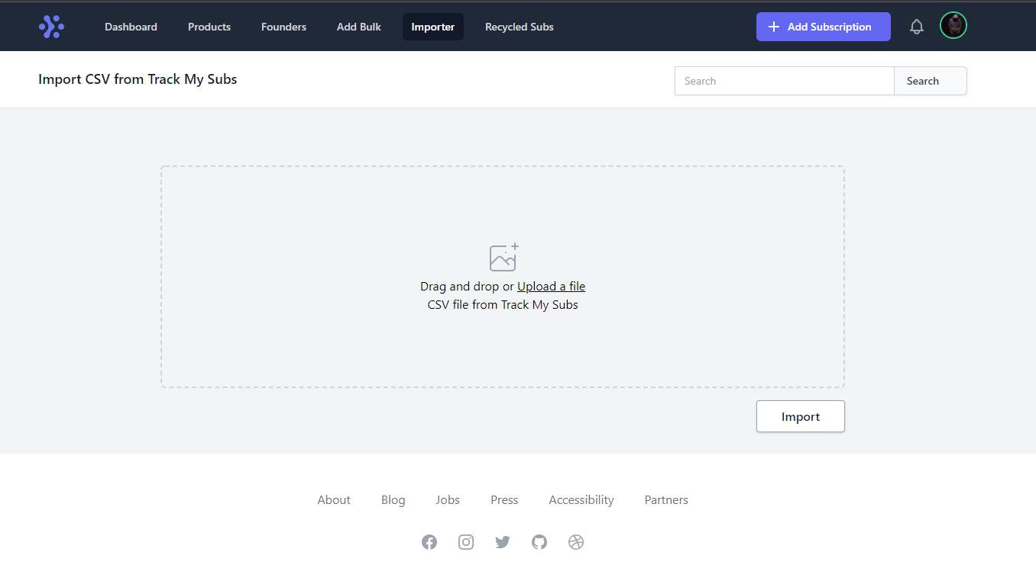
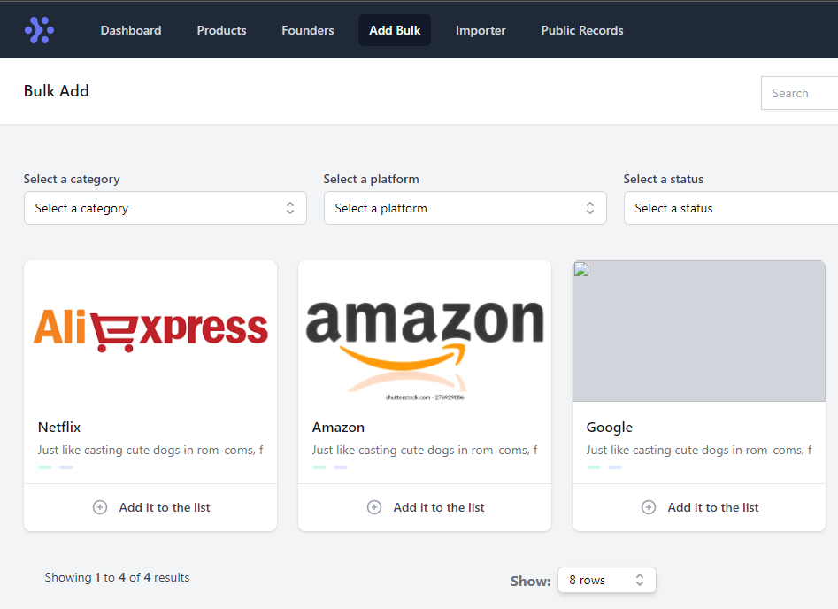

Slide 32
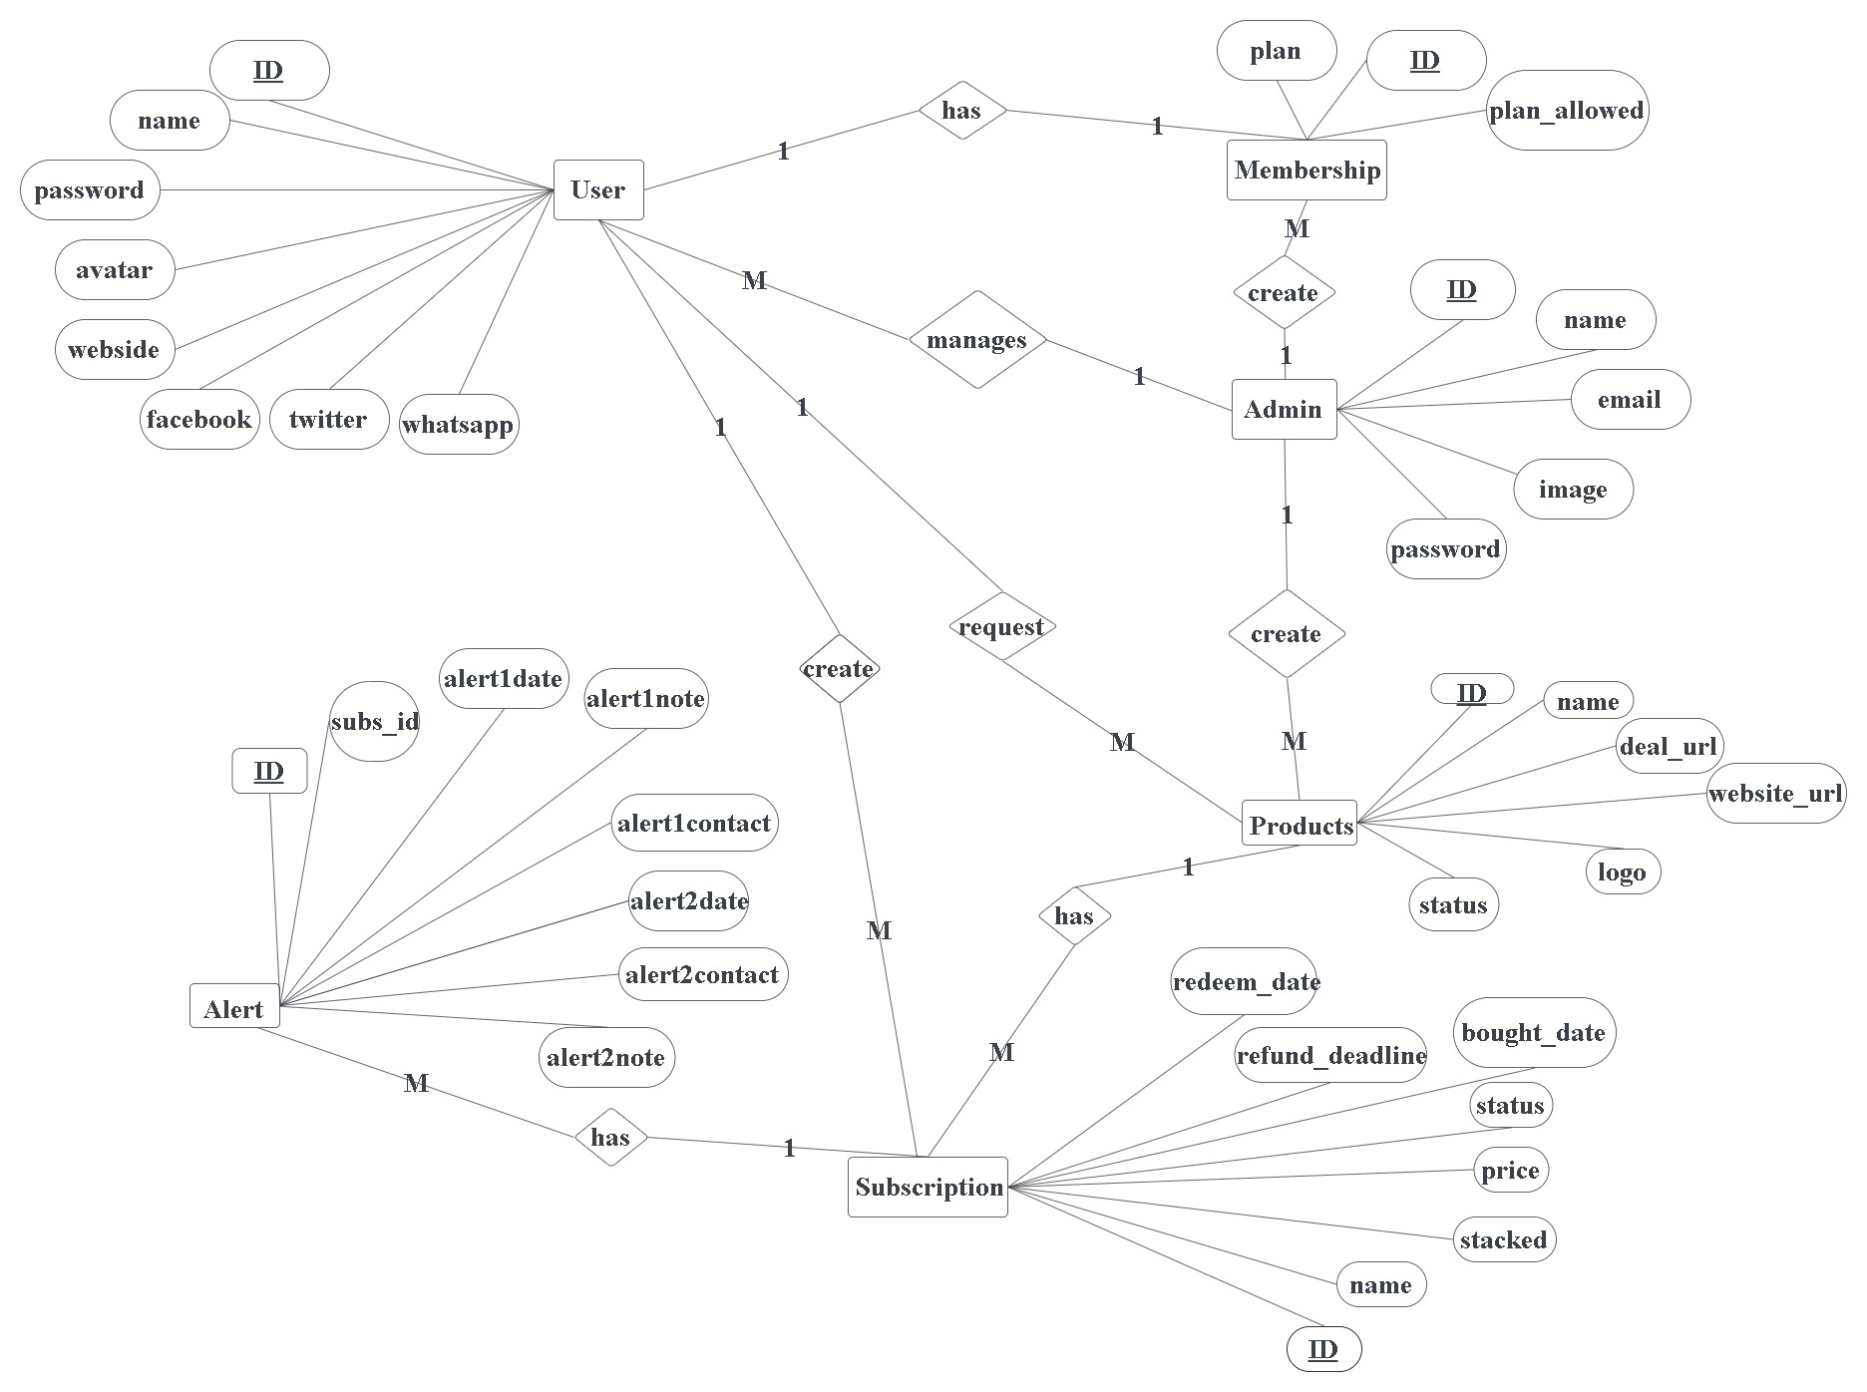
ER Diagram

